Slide 1
What is Publication ethics?
Publication ethics - rules of conduct to be followed while publishing results of scientific research or other scholarly work.
Generally, it is a standard that protects intellectual property and forbids the re-publication of another's work without proper credit.

Slide 2
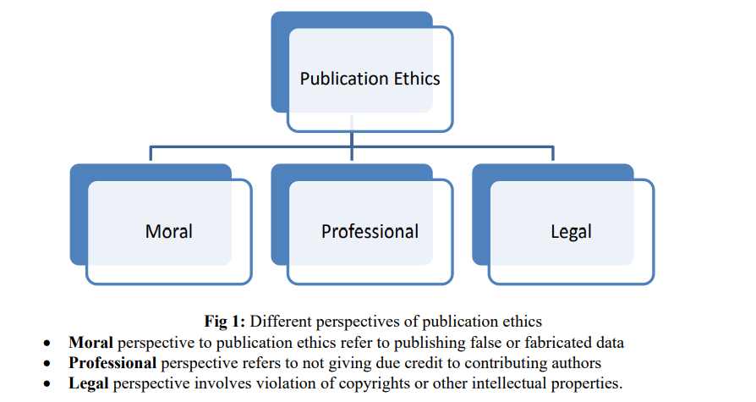
Publication Ethics

Slide 3
Importance of Publication ethics
The importance of publication ethics in scientific research are as follows:
It promotes the aims of the research( knowledge, truth, and avoidance of error). For example, prohibitions against fabricating, falsifying, or misrepresenting research data promote the truth and minimize error.
It promotes the values that are essential to collaborative work(trust, accountability, mutual respect, and fairness).
Ethical norms help to ensure that researchers can be held accountable to the public.

Slide 4
Cont..
It also helps to build public support for research.
People are more likely to fund a research project if they can trust the quality and integrity of the research.
Many of the publication ethics promote a variety of other important moral and social values( social responsibility, human rights, animal welfare, compliance with the law, and public health and safety).
Ethical lapses in research can significantly harm human and animal subjects, students, and the public.

Slide 5
Role and responsibility of authors
As an author of a publication, he/she needs to follow the following publication ethics:
Authors should double-check their research papers in detail for accuracy in calculations, data presentation methods, analysis of results, etc.
Authors must ensure that their research was carried out ethically, and has adhered to relevant regulations.
Authors must follow the regulations of academic journals in peer review, editing, and publication.
Authors must submit manuscripts that are original and must not submit the same paper to more than one academic journal

Slide 6
Cont..
The author should submit data, regulations, procedures, software, lab notes, or other information promptly when requested by the editor.
The research process and method of analysis suggested by the author in the manuscript must be clear so that other researchers can repeat and reproduce the same results.
Researchers must record the procedure and results faithfully and systematically store the evidence. If at any point during the peer review, the reviewers or the journal editor requests the evidence, the researcher must be able to present it.
If there are any limitations present in the research, the researcher must indicate them.

Slide 7
Cont..
Researchers must disclose all financial and non-financial conflicts of interest so that the journal editor, reviewers, and readers are fully aware of such conflicts.
The author must ensure that the manuscript submitted is original and creative and has never been published in any other language or through a different medium.
If the journal editor wishes to publish a manuscript previously published in another journal he or she should obtain permission from the copyright holder. The fact that the article has been reprinted should be disclosed with the source of the original publication.
Authorship should be limited to those who have made a significant contribution to the conception, design, execution, or interpretation of the reported study. All those who have made substantial contributions should be listed as co-authors.

Slide 8
Role and responsibility of publishers
The publishers should adopt the following publication ethics to publish scholarly content in the journals:
Publishers should require authors to confirm that they and their co-authors all meet the journal’s criteria for authorship and that nobody who meets these criteria has been omitted from the list.
Publishers should consider requesting that authors provide a short description of each author’s contribution in an Acknowledgment.

Slide 9
Cont..
Publishers should ask corresponding authors to confirm they have received written authorization from all their co-authors for publication of the article
Publishers should check the plagiarism and inform the authors.
Journal publishers must not attempt to influence the journal’s ranking by artificially increasing any journal metric.

Slide 10
Role and Responsibility of Editors
The editor shall ensure that the peer-review process is fair, unbiased, and timely.
Research articles must typically be reviewed by at least two external and independent reviewers, and where necessary the editor should seek additional opinions.
The editor shall select reviewers who have suitable expertise in the relevant field, taking account of the need for appropriate, inclusive and diverse representation

Slide 11
Cont..
The editor should evaluate manuscripts for their intellectual content without regard to race, gender, sexual orientation, religious belief, ethnic origin, citizenship, or political philosophy of the authors
Editors should ensure confidential handling of manuscripts, with no details being disclosed to anyone except the peer reviewers without the permission of the author. If discussions between an author, editor, and peer reviewer have taken place in confidence they should remain in confidence unless explicit consent has been given by all parties, or unless there are exceptional circumstances

Slide 12
Cont..
Editors should ensure that all those who carry out peer review on behalf of the journal understand and adhere to the need for confidentiality relating to the peer-review process.
Editors should ask peer-reviewers to disclose any conflicts of interest when they respond to an invitation to review and also when they submit their review (since conflicts may only be identified after reading the manuscript).
Editors should only ask authors to add citations to their papers when there is a strong scholarly rationale for this.

Slide 13
Cont..
Respect the confidentiality of peer review, and not discuss the manuscript or contact the authors or any other people about the manuscript.
Provide an objective and constructive explanation for their recommendation.
Avoid requesting that the author cites the peer reviewer’s papers unless there is a strong scholarly rationale for this.
The Editors shold not reproduce information or any part of the manuscript under review in any of their work before publication by the authors.
Only agree to peer review manuscripts within their expertise and within a reasonable timeframe.

Slide 14
Cont..
The Editors shold not delay in publishing the articles.
They should not use insulting, hostile, or defamatory language.

Slide 15
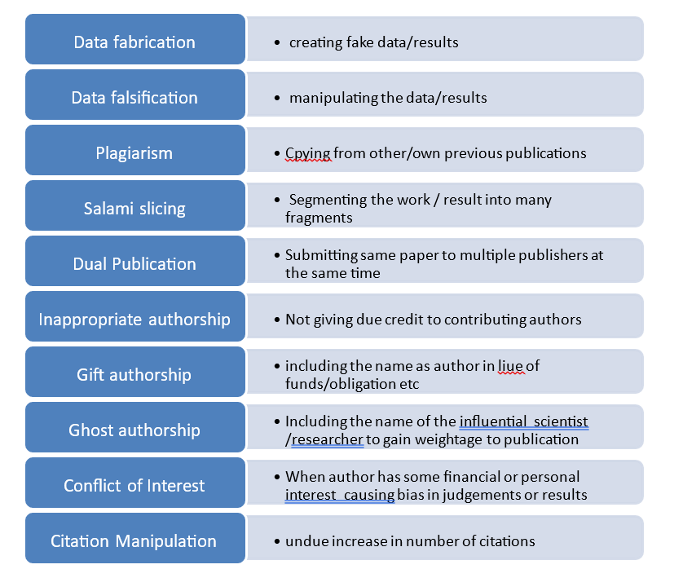

Slide 16
What causes these violations of publication ethics?
In today’s era of ‘publish or perish’ culture, there is immense pressure to publish in order to succeed in the academic career, employment, getting promotions and sometimes for maintaining the job. Bigger is the publication list better is the CV but lacks merit, skills, knowledge. So this race of increasing the count of publication and frequent or continuous publications many times lead to unethical publication practices, distracts you from where we should be actually concentrating on i.e. the actual research work which will help the mankind and society at large.

Slide 17
Conclusion
Hence we as a responsible researcher, author must abstain from any of the unethical practices mentioned above. Concentrate on more quality work and publication which is true, reliable and will take the life a step ahead. If you do not adhere to publication ethics, it may give you false sense of progress for time being but in long run it will cause more harm directly or indirectly.

Slide 18


